Slide 1
Data Wrangling – Part 3

Slide 2
mutate() Function
Command Illustration
new_dataframe_name <- dataframe_name %>%
mutate(new_column_name = computation you want to do)

Slide 3
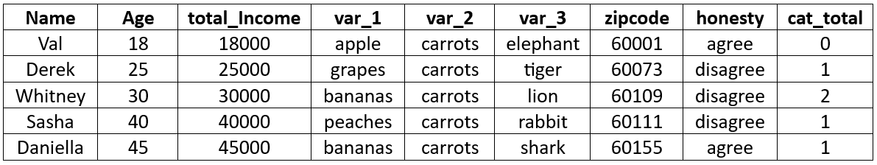
mutate() Function
Illustration_Data

Slide 4
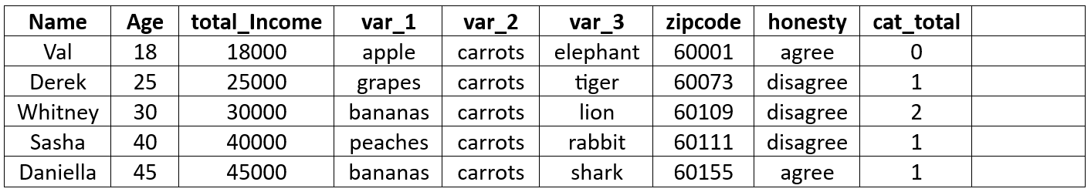
Example 1: Add a new variable "income_per_month" calculated from "total_Income"
example_1 <- Illustration_Data %>%
mutate(income_per_month = total_Income / 12)
Output: The output is a dataframe that looks like this

Slide 5
Example 2: Create a new variable called "status" based on "age"
example_2 <- Illustration_Data %>%
mutate(status = ifelse(Age > 30, "Older","Younger"))
Output: The output is a dataframe that looks like this

Slide 6
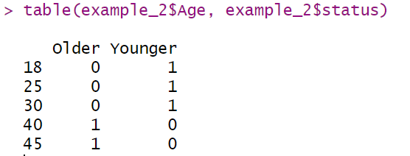
table(example_2$Age, example_2$status)

Slide 7
case_when(
boolean expression ~ value_1,
boolean expression ~ value_2,
...,
TRUE ~ default_value
)

Slide 8
Example 3: Create a new variable "group" based on "age". If the person's age is smaller than 30, they are "Young", if their age is between 30 and 40 (inclusive), then they are "Middle-Aged", if their age is greater than 40, then they are "old".
example_3 <- Illustration_Data %>%
mutate(group = case_when(
Age < 30 ~ "Young",
Age >= 30 & Age <= 40 ~ "Middle-Aged",
Age > 40 ~ "Old"
))

Slide 9
Example 4: Create a new variable "group" based on "age". If the person's age is smaller than 30, they are "Young", if their age is between 30 and 40 (inclusive), then they are "Middle-Aged", anything else, simply have it be "No Category".
example_4 <- Illustration_Data %>%
mutate(group = case_when(
Age < 30 ~ "Young",
Age >= 30 & Age <= 40 ~ "Middle-aged",
TRUE ~ "No Category"
))

Slide 10
Example 5: You can use the mutate function to change the variable type. The variable "total_Income" is numeric. Change it to character.
class(Illustration_Data$total_Income) Output:
Code:
class(Illustration_Data$total_Income) Output:

